Slide 1
Updates 7/6/20
Akash Levy

Slide 2
Overview
Retention results
Updated SDR algorithm
Questions
Retention figures

Slide 3
Retention Results
Before baking: programmed several times until BER goes to 0
Baked at 120C for 30 minutes and remeasured
Obtained BER of 0.5%
Tried cycling 5K times with new SET voltages and rerunning experiment
VWL = 3.5V, VBL = 2V
Did not work!
BER was ~10%

Slide 4
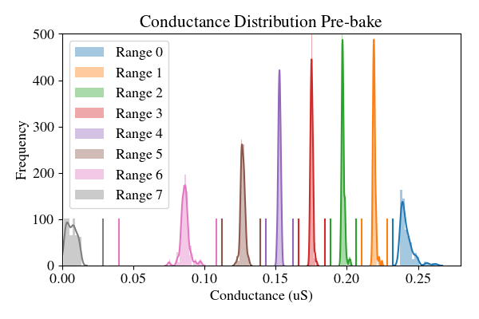
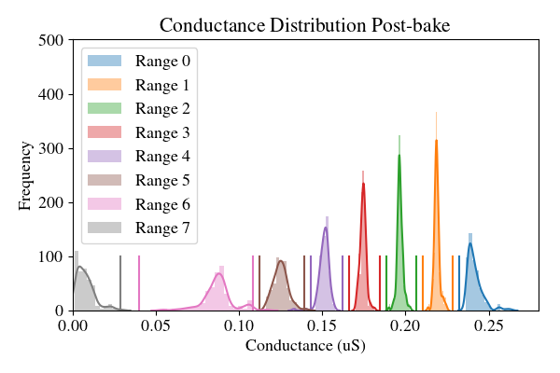
Retention Figures

Slide 5
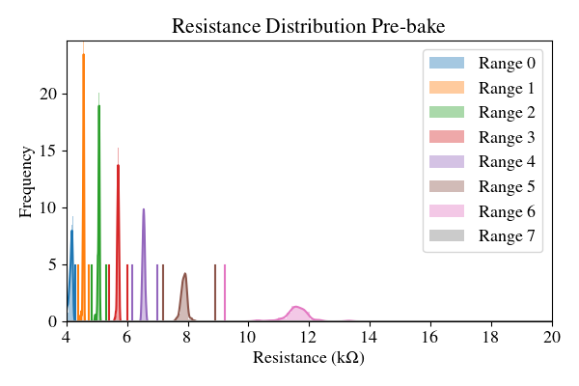
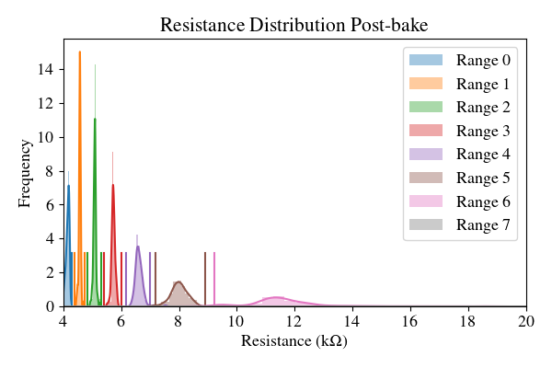
Retention Figures

Slide 6
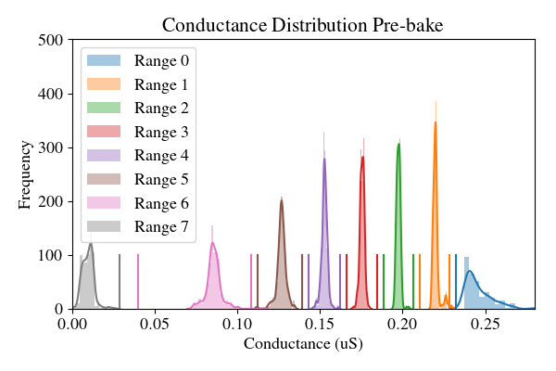
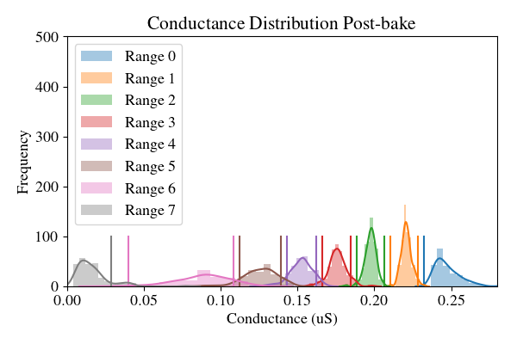
Retention Figures (cycled)

Slide 7
Retention Figures (cycled)

Slide 8
Questions and Ideas
BL fine tuning seems to have been incorrect before
No reason to use coarse tuning voltage as BL start voltage
Should optimize BL start voltage in same way as SL start voltage
Ideas to improve FPPV algorithm yield
“Ping-pong” SET/RESET approach
FPPV has some issues with the low ranges on some cells but this can be fixed using slightly smarter approach
Should we compare to Ray’s algorithm?

Slide 9
Summary of Discussion
For Binh: please allocate 2bpc preliminary ranges (inner and outer)
5kOhm – 12 kOhm allocate 3 ranges
1 range will be HRS
We will measure on 2 chips only to save time
Akash: will work on Gaussian fitting and spread modeling
Plot for paper: BER (y-axis) as a function of time (x-axis) at different target temperatures (different lines)
Akash: will make model for quickly computing time vs. temperature and generating plot
Akash: recompute everything with properly calculated activation energy (2.2eV)
In fine phase, if WL needs to be stepped, it is stepped by 10 mV
Usually takes 3-4 increases on avg. before it goes (not exact number yet!)

Slide 10
Appendix: Ranges
Range # | Rmin(n) (Ω) | Rmax(n) (Ω) | Rwmin(n) (Ω) | Rwmax(n) (Ω)
Range 0 | N.A. | 4300 | N.A. | 4200
Range 1 | 4375 | 4752 | 4540 | 4580
Range 2 | 4844 | 5304 | 5040 | 5090
Range 3 | 5419 | 6012 | 5670 | 5730
Range 4 | 6160 | 6988 | 6510 | 6600
Range 5 | 7189 | 8900 | 7710 | 7870
Range 6 | 9230 | 25000 | 11420 | 11930
Range 7 | 35000 | N.A. | 80000 | N.A.

